Slide 1
Clinical Decision Making and Pattern Recognition in Health Care: Chain Reasoning, Agentic Generative AI, Classification, Prediction, Inference, Clustering, and Time-Series Anomaly Detection for Treatment, Payment, and Operations (TPO)
By: INTERN - Bamisaye Folorunsho – Lead City University, Ibadan Prepared for: Cotiviti

Slide 2
Agenda
Introduction
AI-Driven Healthcare Model
Concept Overview
AI/ML Tasks
AI Approaches
Current Trends
Opportunities
Threats
Strategic Recommendations
Conclusion
Questions

Slide 3
Introduction
Healthcare generates vast clinical, financial, and operational data.
AI improves Treatment, Payment, and Operations (TPO).
Agentic generative AI and large language models (LLMs) automate complex, and multi-step workflows.
Strategic relevance to Cotiviti: enhanced payment integrity and healthcare analytics.

Slide 4
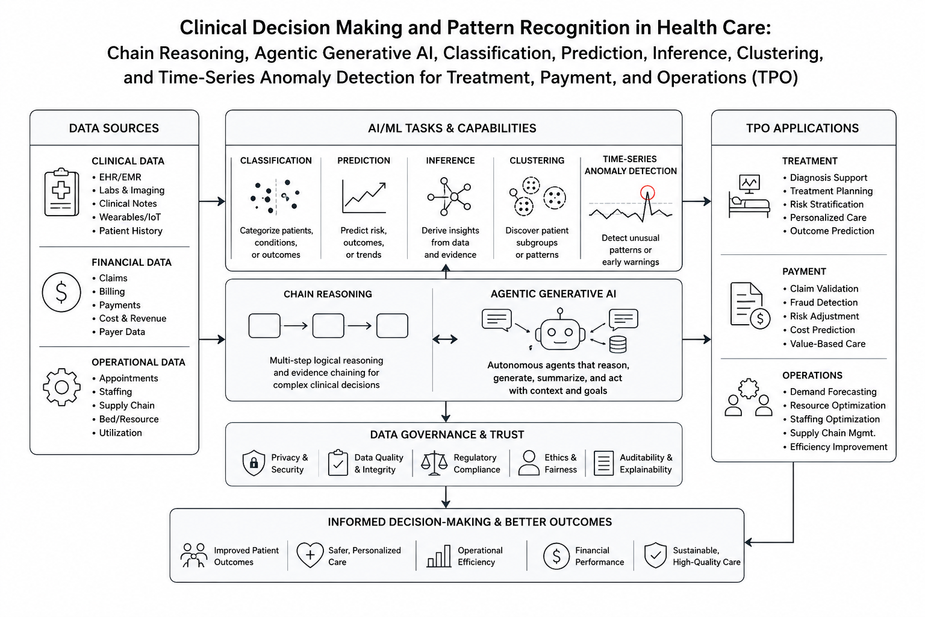
AI-Driven Healthcare Model
Figure i: AI-Driven Healthcare Model

Slide 5
Concept Overview
Clinical Decision Making & Pattern Recognition defined
Clinical Decision Making: The process of diagnosing conditions, selecting treatments, and managing patient care (Topol, 2019).
Pattern Recognition: The process of identifying trends, anomalies, and relationships in structured and unstructured healthcare data (Esteva et al., 2019).

Slide 6
AI/ML Tasks
Classification
Prediction
Inference
Clustering
Time-series anomaly detection

Slide 7
AI Capabilities/Approaches
Chain reasoning
Agentic generative AI

Slide 8
Current Trends
Generative AI for clinical documentation and decision support (Dullabh et al., 2026).
Agentic AI for autonomous healthcare workflows (Hou et al., 2026; Lai et al., 2026).
Predictive analytics for population health management.
Multimodal AI integrating text, medical imaging, laboratory, and monitoring data (Vatsal et al., 2026).

Slide 9
Opportunities
Opportunities are:
Better diagnosis
Earlier disease detection
Claims automation
Lower healthcare costs

Slide 10
Threats
Threats include:
Hallucinations
Bias
Privacy
Security
Regulatory compliance

Slide 11
Strategic Recommendations for Cotiviti
Invest in agentic AI for workflow automation (Hou et al., 2026).
Expand predictive analytics for proactive decision-making (Rajpurkar et al., 2022).
Integrate multimodal AI platforms for comprehensive data analysis (Vatsal et al., 2026).
Strengthen payment integrity and operational efficiency through AI-driven automation.

Slide 12
Proof of Concept Overview AI Clinical Decision Support Portal
Objective:
Develop an interactive clinical decision support prototype that uses a Large Language Model (LLM) to analyze patient symptoms and generate AI-assisted clinical recommendations for Treatment, Payment, and Operations (TPO).
Technology Stack
Python
Streamlit
Hugging Face LLM
JSON API
Native Python Libraries

Slide 13
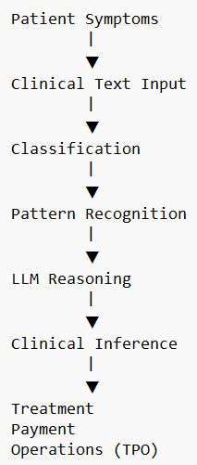
System Workflow Agentic AI Processing Pipeline
Processing Stages
Clinical Text Classification
Pattern Recognition
LLM Chain Reasoning
Clinical Inference
Decision Support

Slide 14
Demonstration
Sample Input
Risk Level
Symptoms
Moderate Risk
Persistent fever (101°F)
Dry hacking cough
Severe headache
Symptoms lasting 48 hours
Recommended Next Steps
Treatment
Rest
Hydration
Antipyretics
AI Output
Possible Conditions
Payment
Acute Viral Upper Respiratory Infection
Influenza
Early COVID-19
Viral Sinusitis
Standard ambulatory billing
Operations
Schedule 48-hour follow-up

Slide 15
Engineering Highlights
Proof of Concept Capabilities
Interactive Streamlit Web Application
Live Clinical Symptom Analysis
Large Language Model (LLM) Integration
Pattern Recognition
Clinical Decision Support
Structured AI Output
Treatment, Payment & Operations (TPO) Recommendations
Automatic Offline Fallback when Cloud AI is Unavailable

Slide 16
Conclusion
AI is transforming healthcare across treatment, payment, and operations (TPO).
Pattern recognition and agentic AI enhance clinical and operational decision-making.
Strategic AI adoption can deliver sustainable clinical, financial, and operational value.

Slide 17
Proof of Concept Overview
AI Clinical Decision Support Portal
Objective:
Develop an interactive clinical decision support prototype that uses a Large Language Model (LLM) to analyze patient symptoms and generate AI-assisted clinical recommendations for Treatment, Payment, and Operations (TPO).

Slide 18
Selected References
Dullabh, P., Zott, C., Gauthreaux, N., Peterson, C., Aronoff, A., Monkhouse, K., & Sittig, D. F. (2026). Integrating generative AI into patient-centered clinical decision support: Research and practice considerations. Journal of Medical Internet Research, 28, e81628. https://doi.org/10.2196/81628
Hou, R., Xue, D., Sun, H., He, P., Zhang, W., & Ruan, T. (2026). CDAFlow: Enhancing LLM clinical decision-making through agentic workflow. Expert Systems with Applications, 316, Article 131806. https://doi.org/10.1016/j.eswa.2026.131806
Kara, S., & Karcioglu, A. A. (2026). LLMs, RAG, and agentic workflow in clinical decision support systems: Bibliometric and systematic analysis. Neural Computing and Applications, 38, 509–523. https://doi.org/10.1007/s00521-026-12279-6
Lai, P., Huang, Z., Huang, X., Xu, D., Li, C., Wang, Z., Cai, H., Li, X., Wu, J., Wang, C., Dai, Q., Li, L., & Yu, T. (2026). An autonomous AI agent for knowledge and data cooperation in ED clinical decision support. npj Digital Medicine. Advance online publication. https://doi.org/10.1038/s41746-026-02869-y
Rajpurkar, P., Chen, E., Banerjee, O., & Topol, E. J. (2022). AI in health and medicine. Nature Medicine, 28(1), 31–38. https://doi.org/10.1038/s41591-021-01614-0
Raposo, H. (2026). Agentic AI for clinical decision orchestration in healthcare systems (SSRN Working Paper). https://papers.ssrn.com/sol3/papers.cfm?abstract_id=6185219
Vatsal, S., Dubey, H., & Singh, A. (2026). Agentic AI in healthcare and medicine: A seven-dimensional taxonomy for empirical evaluation of LLM-based agents. IEEE Access, 14, 4840–4863. https://doi.org/10.1109/ACCESS.2026.3651218

Slide 19
Questions
Thank you for listening
Questions?

